Slide 1
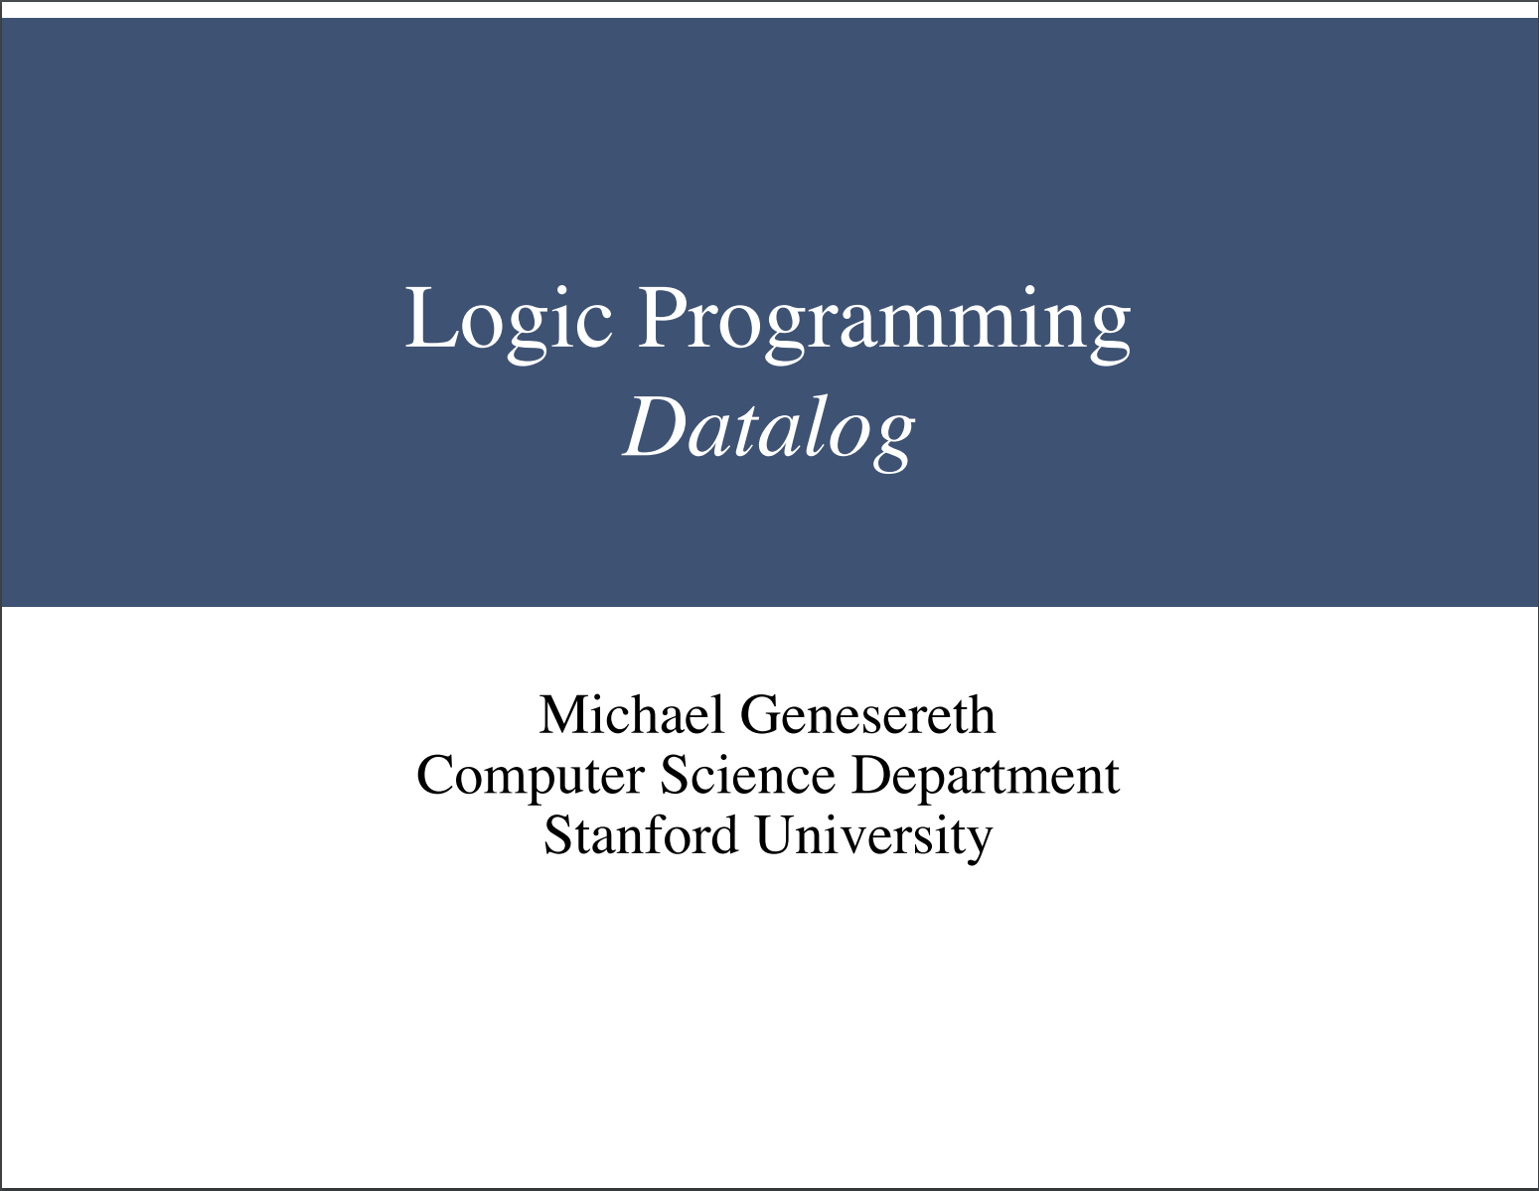

Slide 4
Optimizing Hex
Hunter Guru and Anthony Weng

Slide 5
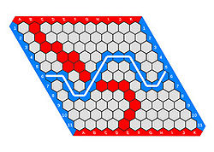
What is Hex?
Hex is a two-player game invented by John Nash and Piet Hein (independently).
Players take turns placing tiles on any cell of their choosing.
Players win by connecting a chain of tiles, such that they form a line spanning from one edge of the board to the opposite edge.
Hex is a game commonly studied by Mathematicians in Computer Science in order to shed light on topics including: graph theory, combinatorics, game theory, and AI.
In 11×11 Hex, there are approximately 2.4×10⁵⁶ possible legal positions! (Approximated using an exponential function and branching factor analysis)

Slide 6
What are we Investigating?
What are the different paradigms in which we can encode the rules of Hex?
How does each paradigm perform (relatively)?

Slide 7
Why Logic Programming? (GDL)
Testing Games in a Generalizable Fashion: Logic Programming is the methodology of describing games in the field General Gameplaying. GDL is widely accepted as the language of General Gameplaying!
Condition Testing: We are really just solving a condition problem, namely: given this set of data, is X true? Logic Programming is very good for that!
Avoiding the “background implementations”: In a traditional imperative programming language, we would have to focus on building the “back-end” framework from game-to-game; logic programming avoids that!

Slide 8
General Observations:
1
2
3
4
5
6
7
8
9
We can assign each cell in the Hex board a numerical index.
In this way, we can codify mathematical rules defining adjacency:
  E.g. Cells X & Y are adjacent if Y = X + 1
One tile must be in each column (or row) in order for a player to have won (as a necessary, but not sufficient condition)
10
…
19
28
37
46
55
64
73
Notes:
One tile must be in each column in order for there to be a victory.
Can codify rules, s.t. two tiles are adjacent.

Slide 9
Approach #1: Naïve Implementation
What if you abstracted half of the problem away from logic programming?
Use logic programming as a “verifier” and another language (Python) to generate the “Winning Sets”.
  E.g. {1,2,3,4,5,6,7,8,9} ∈
After every move, check if the cells “controlled” by a given player is a superset of the winning set.

Slide 10

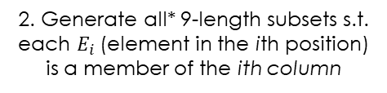




Approach #2: Power-set Constraints
10
{28, 2, 12, 13, 42, 16, 8, 45}
$$n−8$$
$65∈S$?
5
34
2
…
73
46
67
18
{55, 11, 3, 31, 21, 42, 8, 27}
$$n+1$$
$74∈S$?
1. Maintain set of all cells controlled by player p
2. Generate all* 9-length subsets s.t. each $E_{i}$(element in the ith position) is a member of the ith column
3. For each element in a set, check if the subsequent element obeys an “adjacency” rule.
*To avoid repeatedly checking non-winning sets, one can preserve all previous non-winning sets and check all new sets generated by replacing the corresponding column entry in the previously generated sets
E.g. If you play in Column 6 …
${\{C}_{Old}^{(6)}\overset{→}{}C_{New}^{(6)}\}$ in all sets

Slide 11
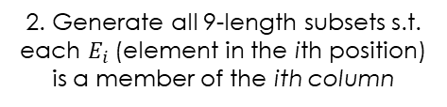

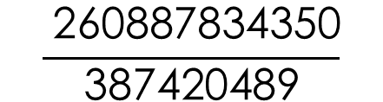

Power-set Constraints: Worst-Case Analysis
Note:
What if we generated all 9-length subsets without our unique column restriction?
Suppose player p controls n cells (n_{max} = 81):
{28, 2, 12, 13, 42, 16, 8, 45}
…
{55, 11, 3, 31, 21, 42, 8, 27}
2. Generate all 9-length subsets s.t. each $E_{i}$(element in the ith position) is a member of the ith column
$$\left(\begin{matrix}81 \\ 9\end{matrix}\right)$$
$9^{9}$
$$\frac{ \text{260887834350}}{\text{387420489}}$$
vs.
≈ x674 more computations!
Notes:
One tile must be in each column in order for there to be a victory.
Can cautify rules, s.t. two tiles are adjacent.

Slide 12
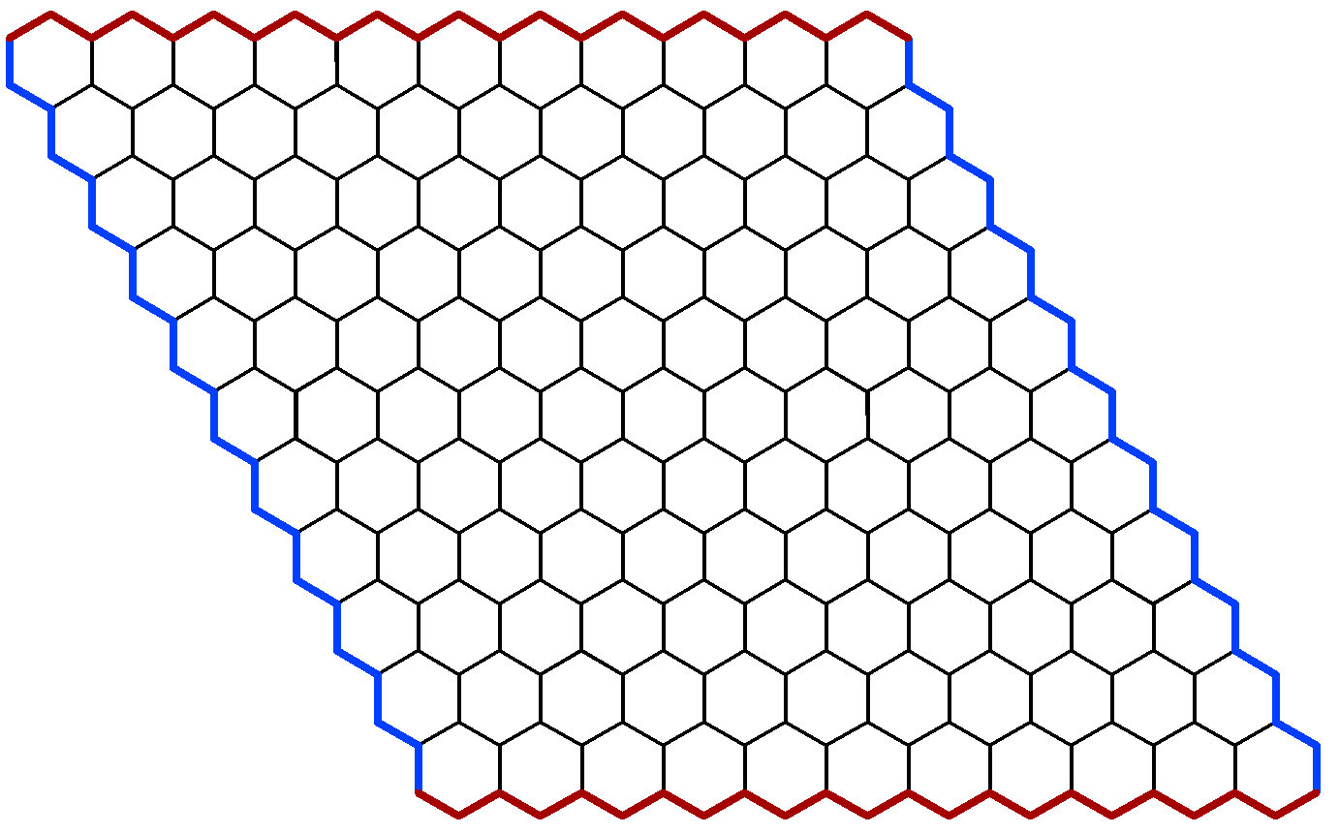
But wait! It isn’t that simple!
This winning sequence is 61 tiles long!

Slide 13

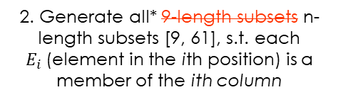
Approach #2: Power-set Constraints*
10
{28, 2, 12, 13, 42, 16, 8, 45}
$$n−8$$
$65∈S$?
5
34
2
…
73
46
67
18
{55, 11, 3, 31, 21, 42, 8, 27}
$$n+1$$
$74∈S$?
1. Maintain set of all cells controlled by player p
2. Generate all* 9-length subsets n-length subsets [9, 61], s.t. each $E_{i}$(element in the ith position) is a member of the ith column
3. For each element in a set, check if the subsequent element obeys an “adjacency” rule.
$$n−9?$$

Slide 14















Approach #3: Following the Line
Column 2
Column 3
$$n−8$$
$$56$$
$$n−8$$
$$57$$
Column 1
…
28
64
$$n+1$$
$$65$$
$$n+1$$
$$66$$
$$n+10$$
$$74$$
$$n+10$$
$$76$$
64
1. For a given player p, consider each cell they control in column 1 (Indices: 1, 10, 19, … ,73)
2. Using the adjacency rules, compute all in the next column (column i + 1) that would be adjacent to the current cell (in column i).
3. If player p controls any of the adjacent cells, repeat the adjacency check. If you can “follow the line” all the way to the end column, the player has won!

Slide 15

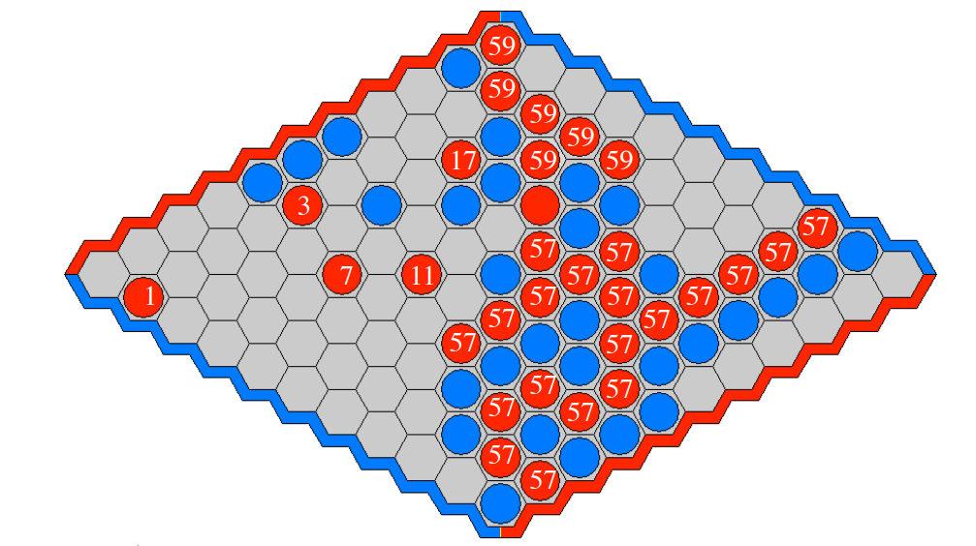
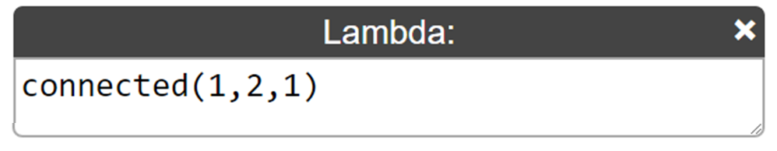
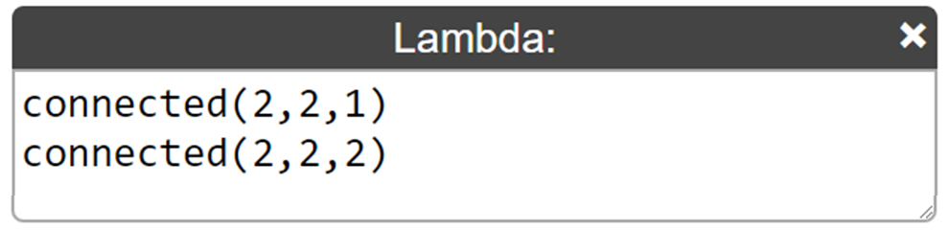
Approach #4 : Minimal Spanning Tree
MRG
approved
Define a “connected” relation: connected(TREE_NUM, ROW, COL)
After each turn, update the connected relations in the dataset:
The game is won if there is some set of connected relations s.t. there exists some “connected(N_{WIN}, R₁, C)” and “connected(N_{WIN}, R₈, C)” (with analogous reasoning extending to spanning a column). This set of connected relations defines the eponymous minimal spanning tree
Credit: M. Genersereth, CS 151, Lecture 12 (Optimization)

Slide 16
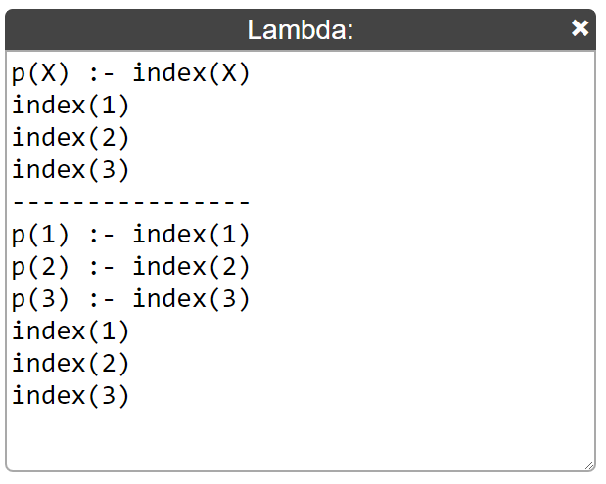




Beyond the Paradigm:
General Optimization Techniques (GOT)
Grounding:
Sub-goal Reordering:
Sub-goal Pruning:

Slide 17
GOT Efficiency Analysis?:
Conjecture: The majority of the time is spent in verifying whether a victory exists or not.
Technique: Devise a particularly difficult example, and see if the verifier can(not) detect a victory.
  Analysis was conducted on a board with 34 tiles filled, and no victory determined.

Slide 18
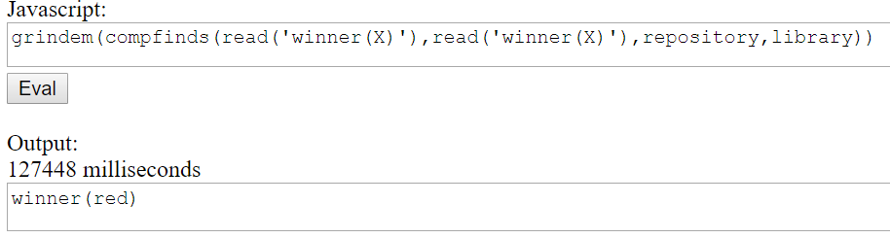
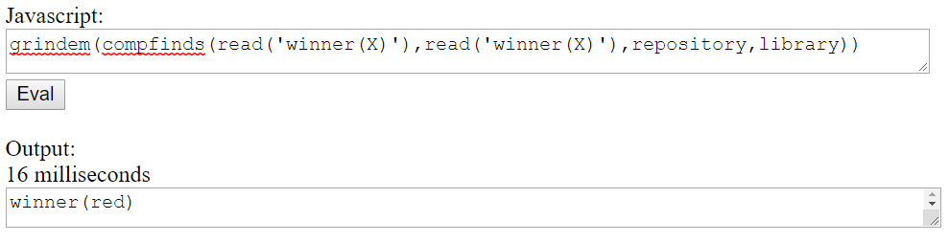
Without grounding and sub-goal reordering
With grounding and sub-goal reordering

Slide 19
Hex as a Maker-Breaker Game
A “Maker-Breaker” game can be thought of a game with two distinct players:
  Maker: wins by taking elements from a finite set until they have a winning set
  Breaker: wins by stopping the Maker
Framing Hex as a Maker-Breaker game:
  Don’t think: “Has Red won? Has Blue won?”
  Think: “Has Red won? Has Red lost? (Can Red still win?)”
Hex implementation:
  After each play, populate all blank cells with red tiles
  On Blue’s turn, if a red path still exists, then Red hasn’t lost
  On Red’s turn, if a red path still exists, then Red can still win!
Maker-Breaker general strategy: populating available moves with Maker’s moves
Notes:
If red has won, impossible for blue to win:
How to test if still possible for blue to win?
After red makes move, take ALL CELLS – SET OF RED-CONTROLLED CELLS = temporarily make all these other tiles blue
If this temp set has some victory for blue, it is still possible for blue to win.

Slide 20
Questions?

